Slide 1

UNIVERSITY OF PETROLEUM & ENERGY STUDIES
School of Computer Science
Dehradun
COURSE: Physical Security July – December 2023
Delivered by
Dr. Gopal Singh Rawat
1

Slide 2
Course Plan
CO1. Introduction to Physical Security CO2. Approaches to Physical Security
CO3. Standards, Regulations and Guidelines
CO4. Fire and Fire Safety Inspection
CO5. Vulnerability Assessment
CO6. Security Surveys and Audit
CO7. Security Lighting, Alarms
CO8. Video, Biometrics, Access Control Standards
CO9. Security Personnel
2

Slide 3
Chapter 8. Video Surveillance, Biometric, Access Control Standards

Slide 4
8.1 Video Surveillance, Biometric, Access Controls
Access Control – security technique regulates who or what can view or gain access to resources
- perform Authorization, Authentication (Identification), Access, Accountability
Uses: Passwords, PIN, Biometric scans, Physical / Electronic Keys/Badges/Cards
Video Surveillance – More prevalent , Video analytics, cost effective reliable means (CCTV)
- apprehend and prosecute offenders
Equipment for security and safety – Alarm, Fire safety, Intrusion control, Access control
Integrated with CCTVs -------> Secure resources

Slide 5
8.1 Video Surveillance, Biometric, Access Controls
Video Technology:
Types - CAMs, CCTVs, Digital Cams (HD Quality)
Use of Video Surveillance:
Collect evidence – Comply with standards
Detect and Record activities of an intruder – theft of assets
Remote Eyes for management - Monitor negligence of staff / employees
Take actions on past/future incidents
Effective for improving security – process, policy review
Integrate with other security controls for enhanced security delivery services

Slide 6
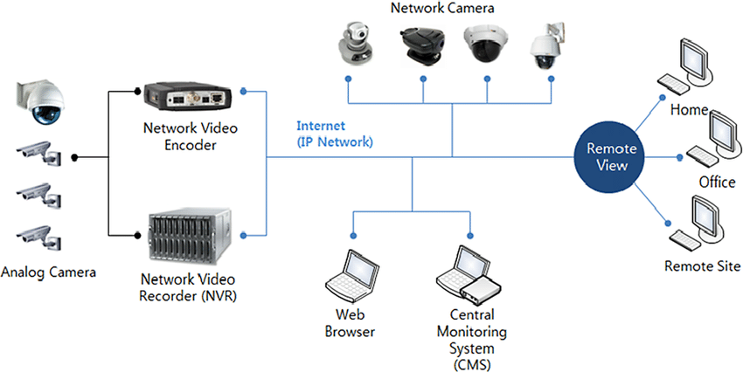
8.1 Video Surveillance

Slide 7
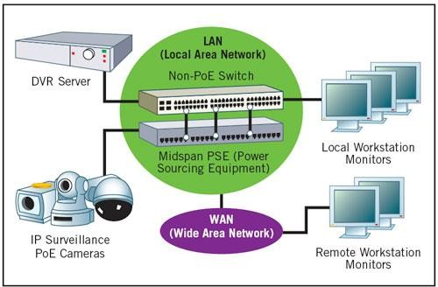
8.1 Video Surveillance
Notes:
DVR – digital video recorder , Power over ethernet (PoE)

Slide 8
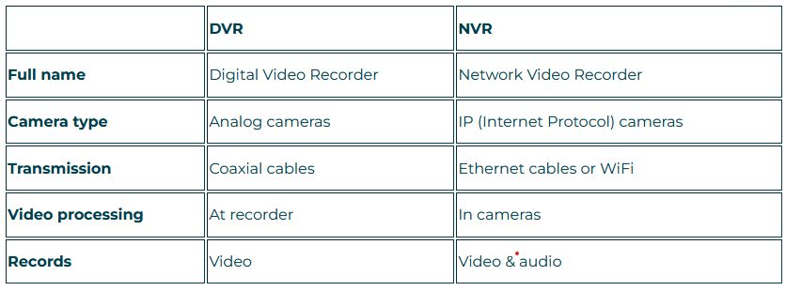
8.1 Video Surveillance
https://solink.com/resources/dvr-vs-nvr-which-is-better/

Slide 9
8.1 Video Surveillance, Biometric, Access Controls
Effectiveness - Integrate Organization’s other / existing Security Controls
Integrated Security Controls
Security Operations
Access Control
Alarms
Communication
Security Personnel
Digital Forensics
Cyber Attacks
IT Policy
Fire
Exchange Email
Guards
Data Loss
Endpoint Console
Electronic
Safety
BYOD SMS
Internal Threat
Ransomware
AntiVirus Logs
Biometric
Water
Phishing
External Threat
Recovery
Network / Server Logs
Locks
Power
Investigations
CCTV
Local News
Crime Cases
Threat Hunting

Slide 10
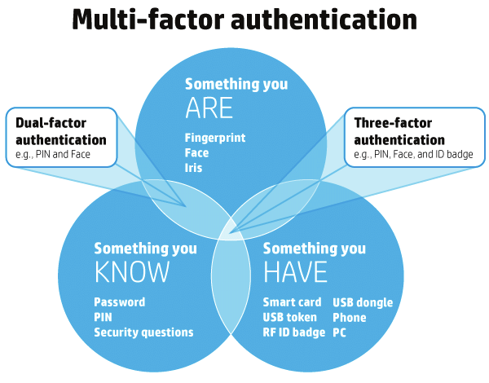
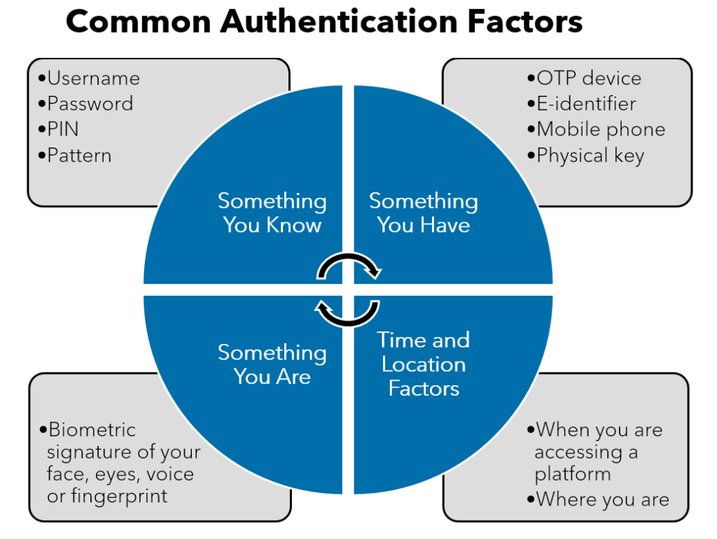
8.2 Video Surveillance, Biometric, Access Controls
Biometrics:
Retina patterns, Finger/Handprints, Facial recognition, Code/PIN with Staff, Access passwords, Keystroke
Authenticate individuals
Establish user identity
Helps enhance security level using multi factor authentication
One Factor Authentication → something you know
Two Factor Authentication → something you have
Three Factor Authentication → something you are

Slide 11
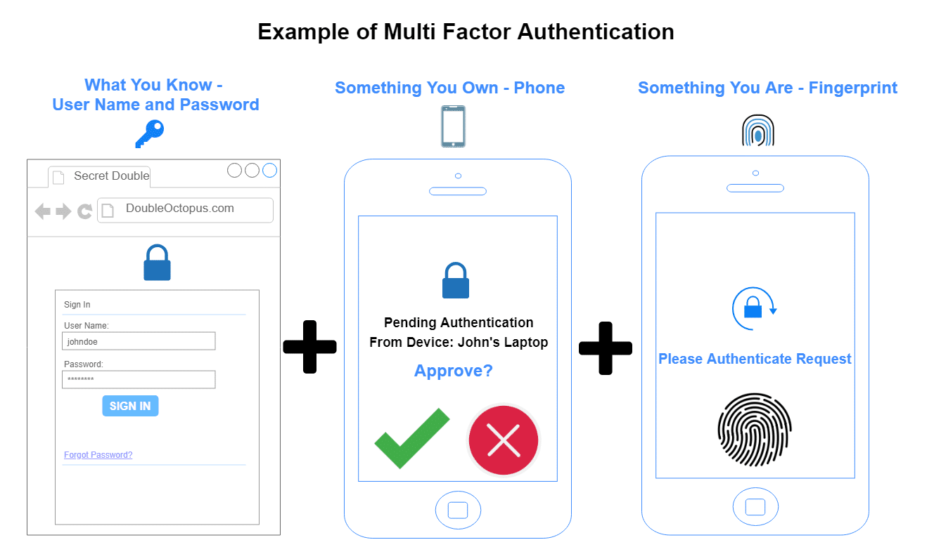

Slide 12
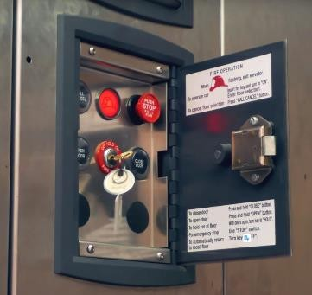
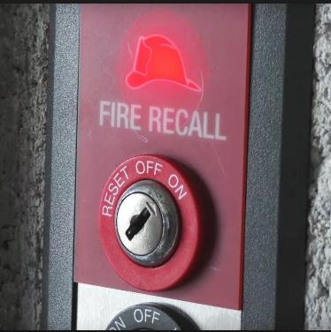
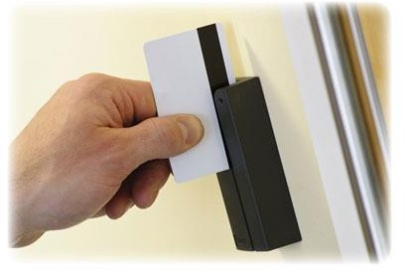
8.3 Video Surveillance, Biometric, Access Controls
Personnel Entry Control Bypass
Access control → ID/Password – Proxy
Consider any bypass routes for use of credentials which have been coded
Keyed locks should be used
Door Sensor
All doors should be secured

Slide 13
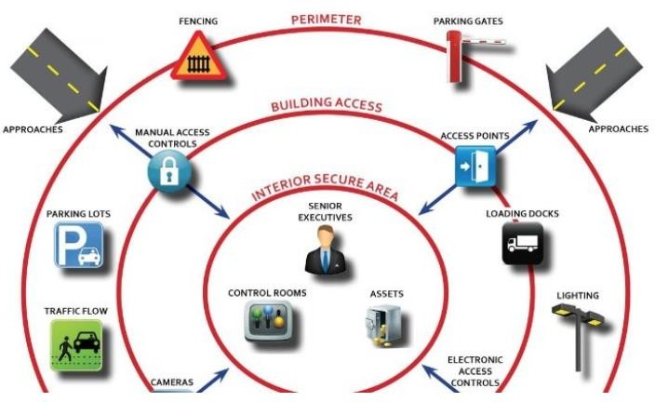
8.4 Security Barriers
Layers of Physical Security:
Outer Layer
Depends on facility location and type.
Outer (Perimeter):
Natural
Terrain
Water Bodies
Man-made (Structural):
Fences
Walls
Gate
Inner Layer
Relates to elements inside building
Inside Barriers:
Guards, Police force
Access Points
Surveillance Controls
Interior
Doors, Locks, Windows
Keys/Combinations
Access Control, Assets, Staff

Slide 14
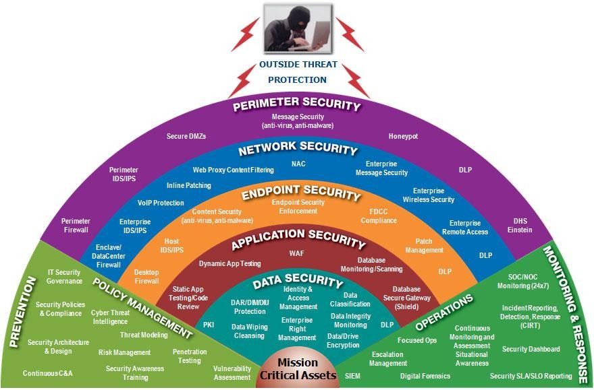
8.4 Security Barriers
Layers of Physical Security:
Outer Layer
Layers of IT Security:
Depends on facility location and type.
Outer (Perimeter):
Natural
Terrain
Water Bodies
Man-made (Structural):
Fences
Walls
Gate
Inner Layer
Relates to elements inside building
Inside Barriers:
Guards, Police force
Access Points
Surveillance Controls
Interior
Doors, Locks, Windows
Keys/Combinations
Access Control, Assets, Staff

Slide 15
8.5 Physical Security Standards
Loss Prevention Standard (LPS 1175, Issue 8, Published 2020) (Loss Prevention Certification Board – LPCB)
Evaluates resistance of unauthorized access offered by physical security products
Ratings
SR1: use minimal tools (pen knife, screwdriver, pliers..)
SR2: use mechanical tools (bolt cutters, drill, saw…)
SR3: use small attack tools (Small Axe, Crowbar, Gas Torch, Rod..)
SR4: use higher level of tools (Felling Axe, Sledge Hammer, Steel Wedge, Disc Grinder)
SR5: use battery power tools (circular saw, zig saw blades)
LPS 1175 Issue 7
Low Risk
Rating | Tool Category | Max Work Time | Max Test Duration | Domestic | Commercial | Government
SR1 | A | 1 | 10
SR2 | B | 3 | 15
SR3 | C | 5 | 20
SR4 | D | 10 | 30
SR5 | D+ | 10 | 30
SR6 | E | 10 | 30
SR7 | F | 10 | 30
SR8 | G | 20 | 60
High Risk
What is LPS 1175? The Definitive Guide | HS Security
LPS 1175 Security Ratings Explained: Guide to LPS 1175 (charter-global.com)
Notes:
Loss Prevention Certification Board (LPCB) is a globally recognised third-party certification body under Building Research Establishment (BRE) group

Slide 16
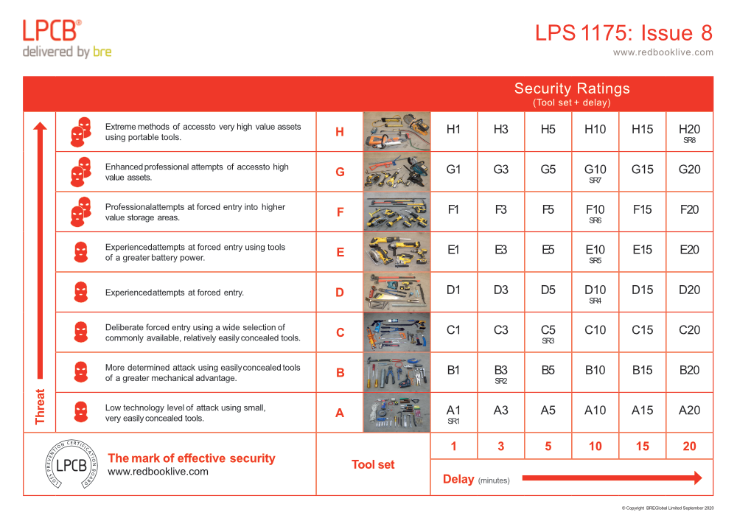
8.5 Physical Security Standards
Notes:
Building Research Establishment (BRE)

Slide 17
8.5 Physical Security Standards
What are the toolkits used for the Issue 8 rating?
Toolkit A: Cable cutters, hexagon wrenches, knives, lever and pliers
Toolkit B plus those within Toolkit A: Bolt cutters, claw hammers, drills, junior hacksaw, metal plate shears, multiple slip joint pliers, pipe wrench, pliers, screwdrivers, socket sets
Toolkit C plus those within Toolkit A & B: Axe, Bolt cutters, brick bolster, cold chisel, crowbars, drills, hacksaw, pad saw, scissor jack
Toolkit D plus those within Toolkit A, B & C: Bolt cutters, ‘A-tool’ lock puller, fire axe, general purpose saw, grinder, hole saw, hooligan bar, jigsaw, plate shears, sledgehammer
Toolkit E plus those within Toolkit A, B, C & D: Circular saw, drill (rotary and hammer action), cordless grinder, reciprocating saw
Toolkit F plus those within Toolkit A, B, C, D & E: 36V battery, chisel bits, circular saw, disc grinder, rotary hammer action and SDS drill, step drill/cone cutter drill bit, glasmaster saw, pickaxe, pinch bar,
Toolkit G plus those within Toolkit A, B, C, D, E & F: 54V battery, chisel bits, chainsaw, 54W circular saw, 54V disc grinder, 54V drill, 450mm enforcer, grinder (2 stroke), 4 tonne trolley jacks
Toolkit H plus those within Toolkit A, B, C, D, E, F & G: Arcair, concrete chainsaw, diamond core drill bit, 800mm enforcer, 5-tonne hydraulic head and toe jack, oxyacetylene cutting kit, rescue chainsaw, 5kW ring saw
Remember : physical security concerns four main areas:
Deterring intruders, Detecting and Delaying attackers, and Responding to an attack.

Slide 18
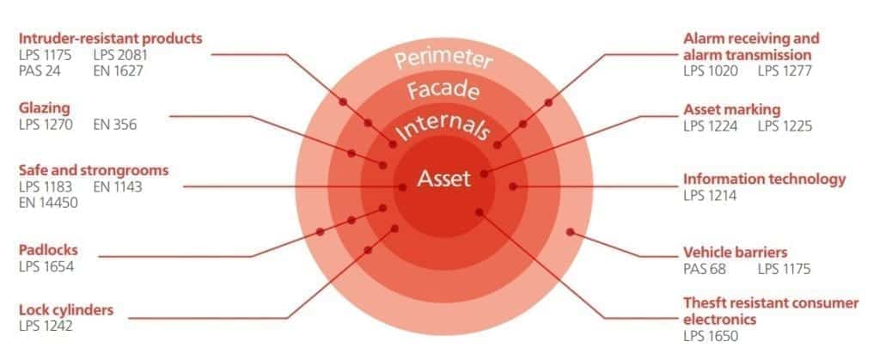
8.5 Physical Security Standards

